Slide 1

Research Methodology
Hypothesis Testing
Unit 3
Dr. Arti Arya
Department of Computer Science and Engineering

Slide 2

Research Methodology
Hypothesis Testing
Chapter 10
Dr. Arti Arya
Department of Computer Science and Engineering

Slide 3
Research Methodology
Disclaimer
These slides are prepared from the prescribed text book and other reliable resources from the Internet.
The images are imported from various sites and videos are imported from youtube.com

Slide 4

Research Methodology
Hypothesis
Considered as principal instrument in research.
Experiments are carried out with a deliberate objective of testing a hypothesis.
Hypothesis testing is mostly used as a strategy for deciding whether a sample data offer such support for a hypothesis that generalisation can be made.
In layman’s language, one simply means a mere assumption or some supposition to be proved or disproved.
Hypothesis is a claim that is testable on the basis of observed data modelled as the realised values taken by a collection of random variables.

Slide 5
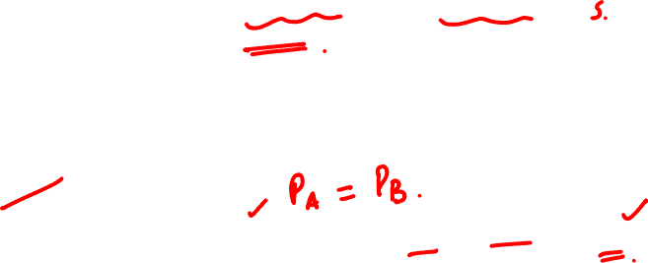
Research Methodology
Hypothesis
May be defined as a proposition or a set of proposition set forth as an explanation for the occurrence of some specified group of phenomena either asserted merely as a provisional conjecture to guide some investigation or accepted as highly probable in the light of established facts.
Example:
The automobile A is performing as well as automobile B.
OR
Athlete who receive training will perform better than the athlete not receiving training.

Slide 6

Research Methodology
Hypothesis
A hypothesis states what we are looking for and it is a proposition which can be put to a test to determine its validity.

Slide 7

Research Methodology
Characteristics of Hypothesis
Should (be):
Some prior study may be done by the researcher in order to make hypothesis testable.
A Hypotheses is testable if other deductions can be made from it which, in turn, can be confirmed or disproved by observation.
A narrower hypothesis is more testable.
1. Clear and precise.
2. Capable of being tested.
3. State relationship between variables.
4. Limited in scope and must be specific.
5. Stated in simple terms and easily understandable.
6. Consistent with most known facts.
7. Amenable to testing within reasonable time.

Slide 8
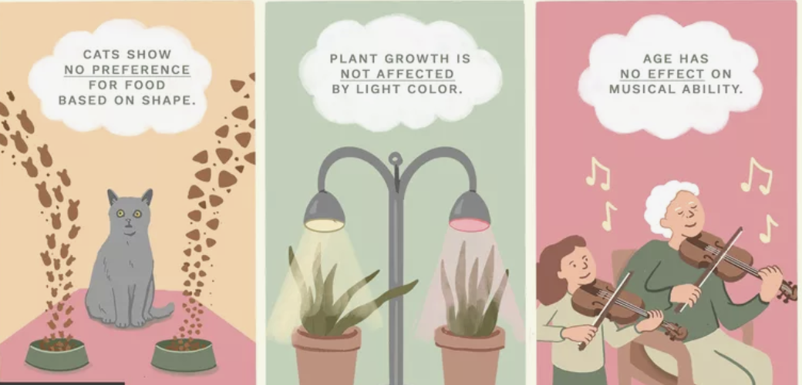
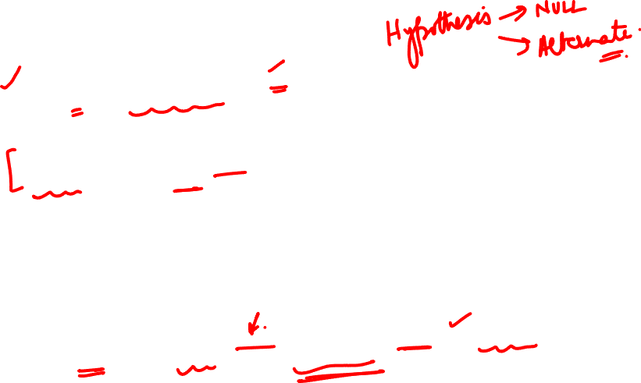
Research Methodology
Null Hypothesis and Alternative Hypothesis
Null Hypothesis – If we compare method A and method B and both are equally good (H0).
OR
which assumes that there is no meaningful relationship between two variables( dependent and independent)—may be the most valuable hypothesis for the scientific method because it is the easiest to test using a statistical analysis
Say, you suspect that there is a relationship between a set of variables. One way to prove that this is the case is to reject the null hypothesis.
https://www.thoughtco.com/null-hypothesis-examples-609097

Slide 9
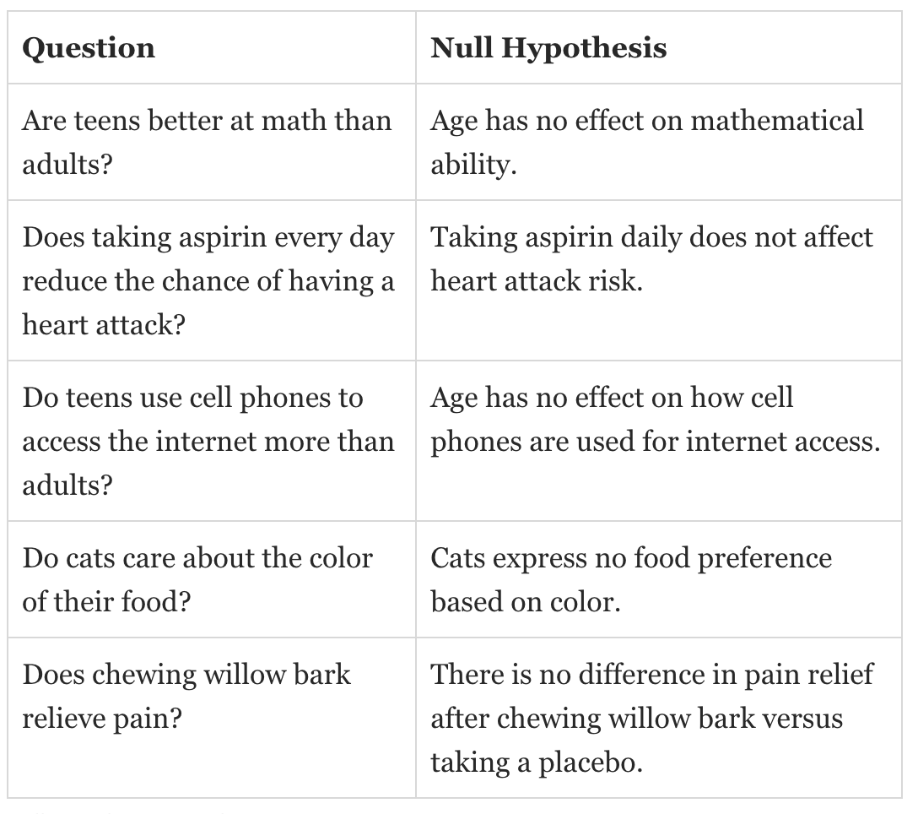

Research Methodology
Null Hypothesis
Rejecting a hypothesis does not mean an experiment was "bad" or that it didn't produce results. In fact, it is often one of the first steps toward further inquiry.
To write a null hypothesis, first start by asking a question.
https://www.thoughtco.com/null-hypothesis-examples-609097

Slide 10
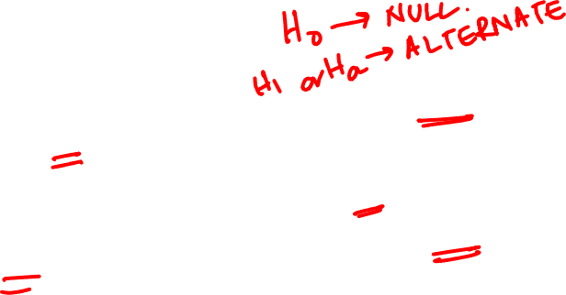
Research Methodology
Alternative Hypothesis
In Null Hypothesis (H₀), we consider that method A and method B are equally good.
But we can always claim that method A is better than B or B is inferior to A and such a hypothesis is Alternative Hypothesis.

Slide 11

Research Methodology
Null Hypothesis and Alternative Hypothesis: Example
Hypotheses with One Sample of One Categorical Variable
About 10% of the human population is left-handed. Suppose a researcher at Penn State speculates that students in the College of Arts and Architecture are more likely to be left-handed than people found in the general population. We only have one sample since we will be comparing a population proportion based on a sample value to a known population value.
Research Question: Are artists more likely to be left-handed than people found in the general population?
Response Variable: Classification of the student as either right-handed or left-handed
State Null and Alternative Hypotheses
Example from: https://online.stat.psu.edu/stat100/lesson/10/10.1

Slide 12

Research Methodology
Null Hypothesis and Alternative Hypothesis: Example
Hypotheses with One Sample of One Categorical Variable
Null Hypothesis:
Students in the College of Arts and Architecture are no more likely to be left-handed than people in the general population (population percent of left-handed students in the College of Art and Architecture = 10% or p = .10).
Alternative Hypothesis:
Students in the College of Arts and Architecture are more likely to be left-handed than people in the general population (population percent of left-handed students in the College of Arts and Architecture > 10% or p > .10). This is a one-sided alternative hypothesis.
Example from: https://online.stat.psu.edu/stat100/lesson/10/10.1

Slide 13

Research Methodology
Null Hypothesis and Alternative Hypothesis: Example
Hypotheses with Two Samples of One Categorical Variable
Many people are starting to prefer vegetarian meals on a regular basis. Specifically, a researcher believes that females are more likely than males to eat vegetarian meals on a regular basis.
Research Question: Does the data suggest that females are more likely than males to eat vegetarian meals on a regular basis?
Response Variable: Classification of whether or not a person eats vegetarian meals on a regular basis
Explanatory (Grouping) Variable: Gender
State Null and Alternative Hypotheses
Example from: https://online.stat.psu.edu/stat100/lesson/10/10.1

Slide 14
Research Methodology
Hypothesis
Null Hypothesis:
There is no gender effect regarding those who eat vegetarian meals on a regular basis (population percent of females who eat vegetarian meals on a regular basis = population percent of males who eat vegetarian meals on a regular basis or p_{females} = p_{males}).
Alternative Hypothesis:
Females are more likely than males to eat vegetarian meals on a regular basis (population percent of females who eat vegetarian meals on a regular basis > population percent of males who eat vegetarian meals on a regular basis or p_{females} > p_{males}). This is a one-sided alternative hypothesis.
Example from: https://online.stat.psu.edu/stat100/lesson/10/10.1

Slide 15
Research Methodology
Hypothesis: Example
Experts recommend elderly people between 70-75 years to get health checkup done at least twice a year .
Authorities suspect that elderly people are getting health checkup done less than twice a year.
To test this, a random sample of 80 elderly people was taken and asked them how many times do they get health checkup done annually.
Mean =1.5
Alternate H1: avg no. of times health checkup is done annually < 2
H0 : µ >= 2

Slide 16
Research Methodology
Statistically Significant
Measurements are done on the two categorical variables on a sample of individuals from a population, and they are interested in whether or not there is a relationship between the two variables in the population.
A relationship as strong as the one observed in the sample (or stronger) would be unlikely without a real relationship in the population, then the relationship in the sample is said to be statistically significant.
The notion that it could have happened just by chance is deemed to be implausible.
16

Slide 17
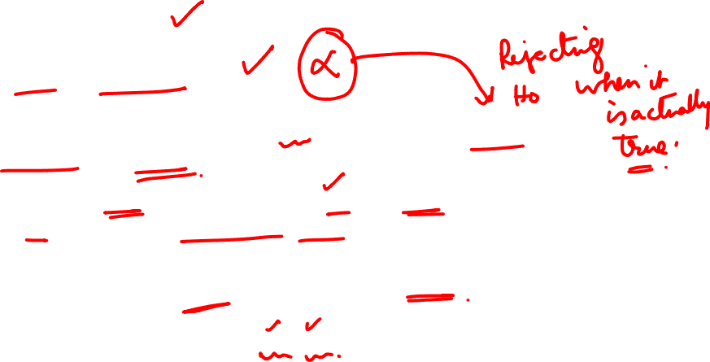
Research Methodology
Level of Significance
The level of significance:
The significance level, also denoted as α, is the probability of rejecting the null hypothesis when it is true
Ex : a significance level of 0.05 indicates a 5% risk of concluding that a difference exists when there is no actual difference
This is a very important concept in the context of hypothesis testing.
It is always some percentage (usually 5% or 1%) which should be chosen with great care, thought and reason.
17

Slide 18

Research Methodology
Type 1 and Type 2 errors
Type 1 error
If Null hypothesis is rejected when it is true
Type 2 error.
If Null hypothesis is accepted when it is not true
In other words
Type1 means – rejection of hypothesis when should have been accepted and
Type 2 means accepting hypothesis when should have been rejected.
λ
λ
λ
18

Slide 19
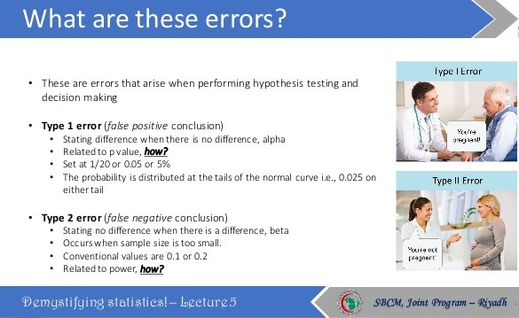
Research Methodology
Type 1 and Type 2 errors
10/11/22
UE20CS506A
19

Slide 20
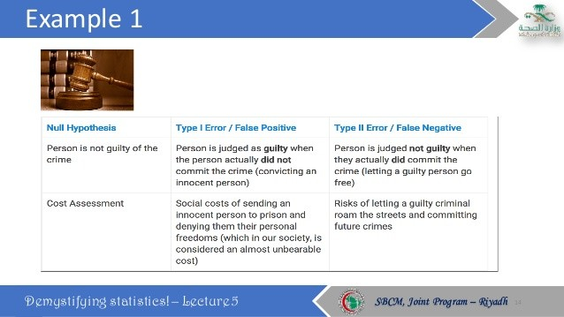
Type 1 and Type 2 errors
20

Slide 21
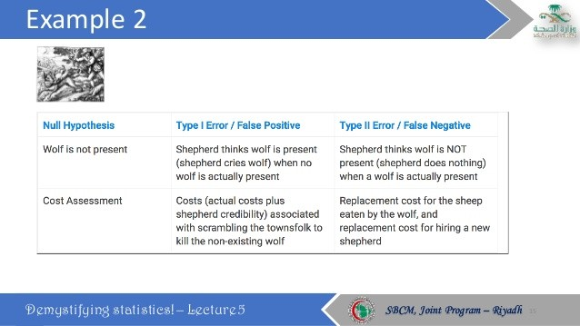
21

Slide 22
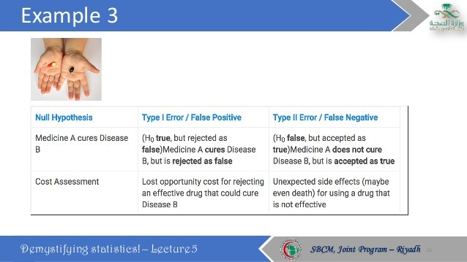
Type 1 and Type 2 errors
22

Slide 23
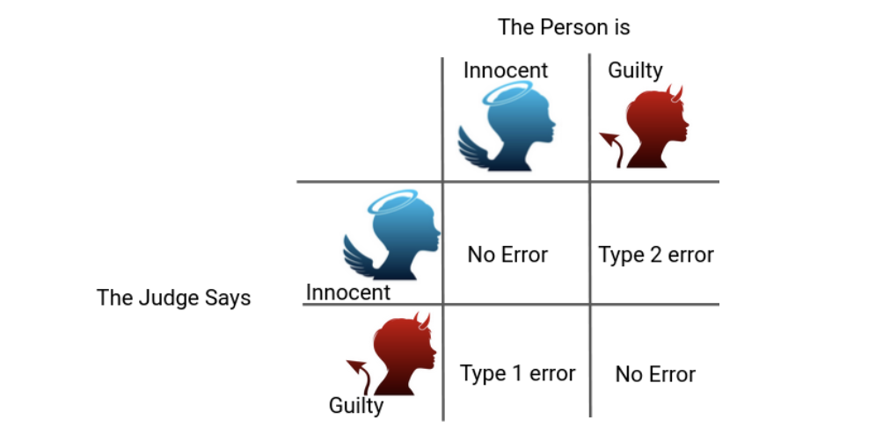
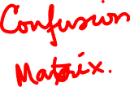
Type 1 and Type 2 Errors
https://www.analyticsvidhya.com/blog/2020/06/statistics-analytics-hypothesis-testing-z-test-t-test/
23

Slide 24
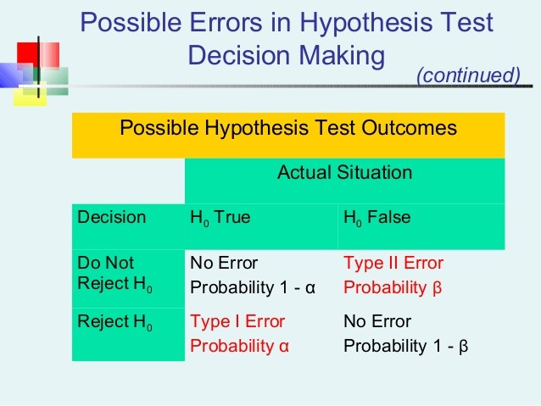
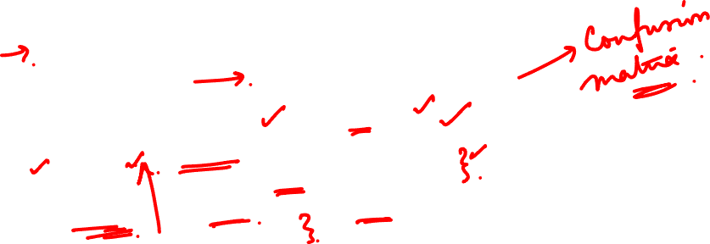
Type 1 and Type 2 Errors
Level of significance, α, is basically the probability of Type I error.
24

Slide 25
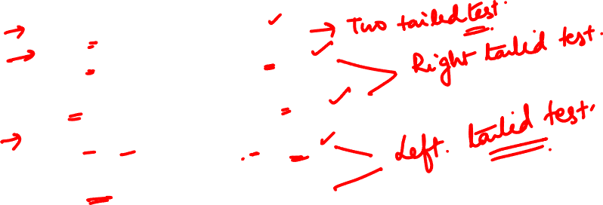
One tailed and two tailed test
We test 3 types of Hypotheses given by:
1) H₀:µ =µ_{H0} Against H_{a}:µ ≠ µ_{H0}
λ
2) H₀ :µ = µ_{H0} Against H_{a} :µ > µ_{H0}
or
H₀ :µ <= µ_{H0} Against H_{a} :µ > µ_{H0}
3) H₀ :µ = µ_{H0} Against H_{a} :µ < µ_{H0}
or
H₀ :µ >= µ_{H0} Against H_{a} :µ < µ_{H0}
If we have ≠ in alternate hypotheses – Two tailed test
If we have > sign in alternate hypotheses – right tailed
If we have < sign in alternate hypotheses – left tailed
25

Slide 26
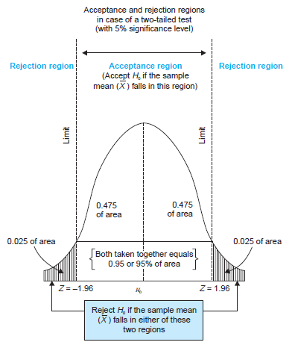
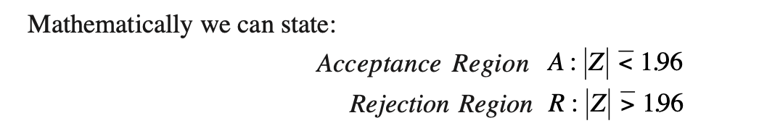
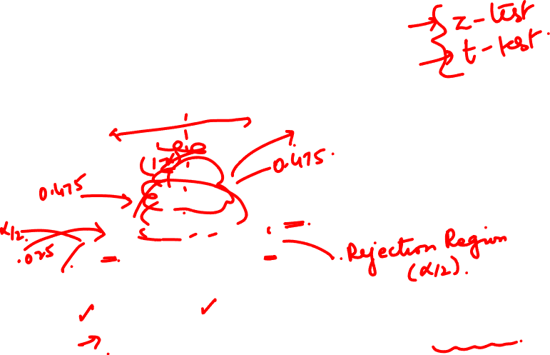
One tailed and two tailed test
λ
λ
λ
H₀:µ =µ_{H0}
H_{a}:µ ≠ µ_{H0}
λ
If we have ≠ in alternate hypotheses – Two tailed test
26

Slide 27
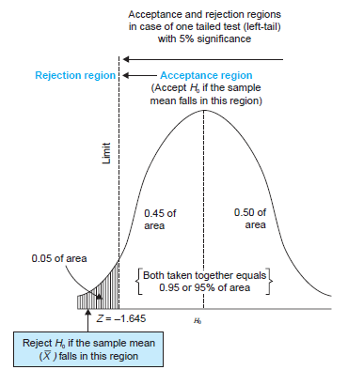
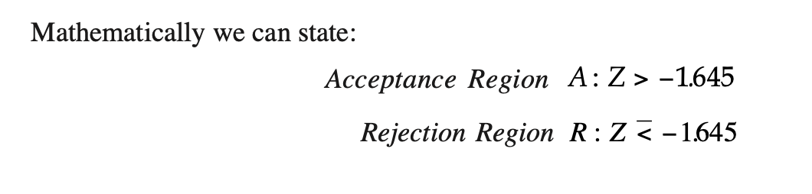
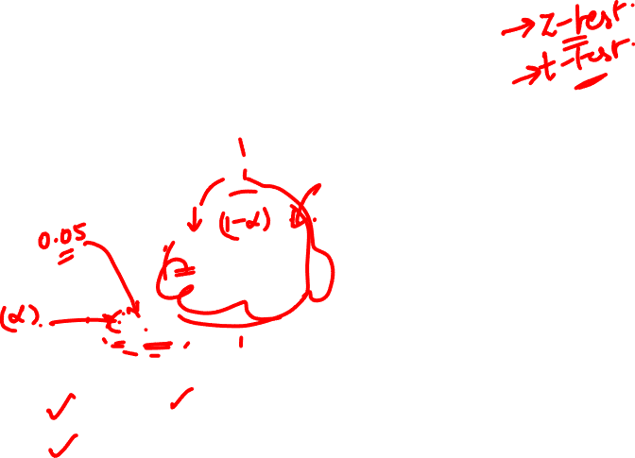
One tailed and two tailed test
H₀ :µ = µ_{H0}
H_{a} :µ < µ_{H0}
If we have < sign in alternate hypotheses – left tailed
27

Slide 28
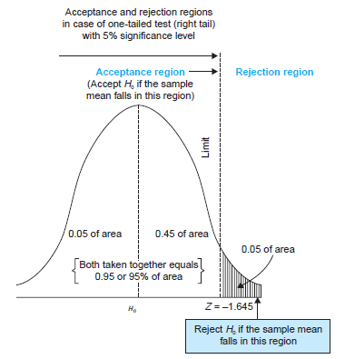
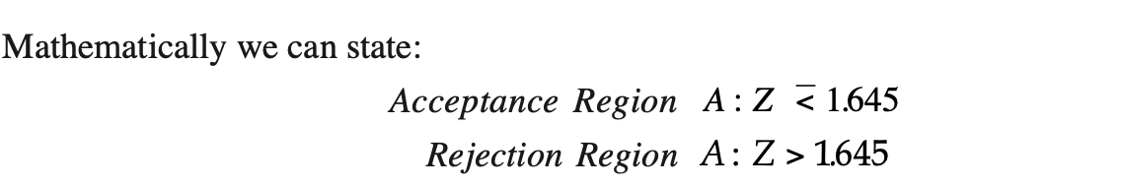
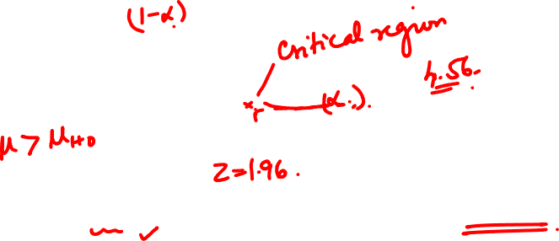
One tailed and two tailed test
λ
λ
λ
H₀ :µ = µ_{H0}
H_{a} :µ > µ_{H0}
λ
If we have > sign in alternate hypotheses – right tailed
28

Slide 29
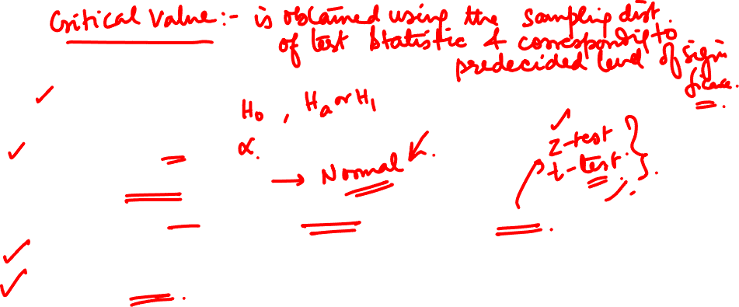
Procedure of Hypothesis Testing
Making a Formal Statement
Selecting a significance level
Deciding the distribution to be used
Selecting a random sample and computing an appropriate value(Compute the test statistics)
Calculation of Probability
Comparing the probability
Making a decision based on p-value
Refer text book for more details
29

Slide 30
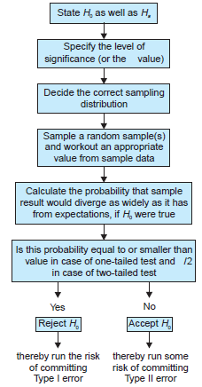
Steps in Hypothesis Testing
30

Slide 31
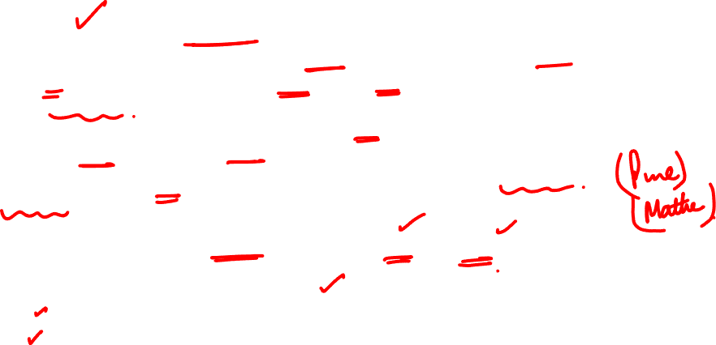
What are Parametric Tests?
The basic principle behind the parametric tests is that we have a fixed set of parameters that are used to determine a probabilistic model that may be used in Machine Learning as well.
Parametric tests are those tests for which we have prior knowledge of the population distribution (i.e, normal), or if not then we can easily approximate it to a normal distribution which is possible with the help of the Central Limit Theorem.
Parameters for using the normal distribution is –Mean, Standard Deviation.
Parametric Tests for Hypothesis testing
T-test
Z-test
F-test
ANOVA
https://www.analyticsvidhya.com/blog/2021/06/hypothesis-testing-parametric-and-non-parametric-tests-in-statistics/

Slide 32
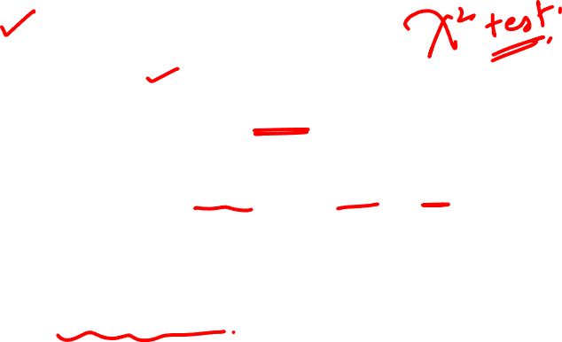
What are Non-parametric Tests?
In Non-Parametric tests, we don’t make any assumption about the parameters for the given population or the population we are studying. In fact, these tests don’t depend on the population.
Hence, there is no fixed set of parameters is available, and also there is no distribution (normal distribution, etc.) of any kind is available for use.
This is also the reason that nonparametric tests are also referred to as distribution-free tests.
https://www.analyticsvidhya.com/blog/2021/06/hypothesis-testing-parametric-and-non-parametric-tests-in-statistics/

Slide 33
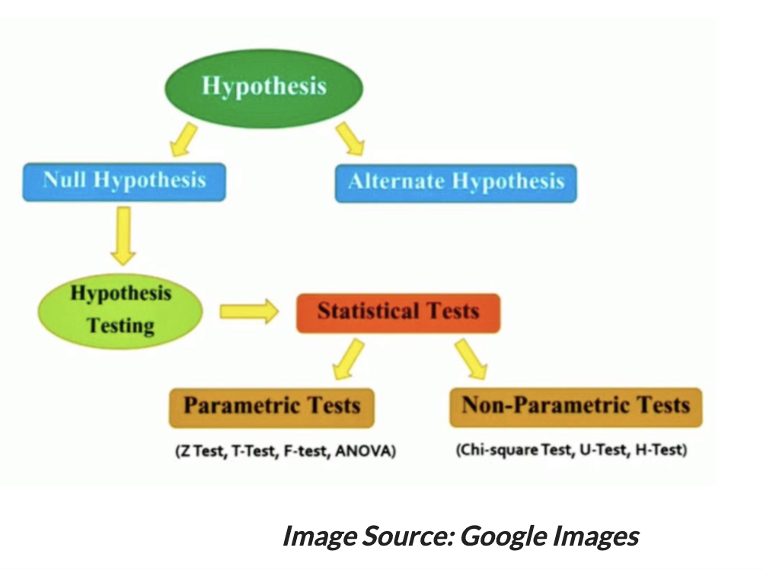
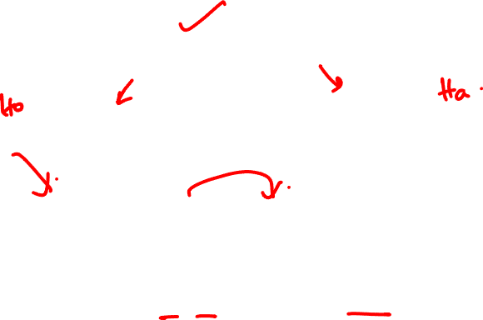
https://www.analyticsvidhya.com/blog/2021/06/hypothesis-testing-parametric-and-non-parametric-tests-in-statistics/

Slide 34
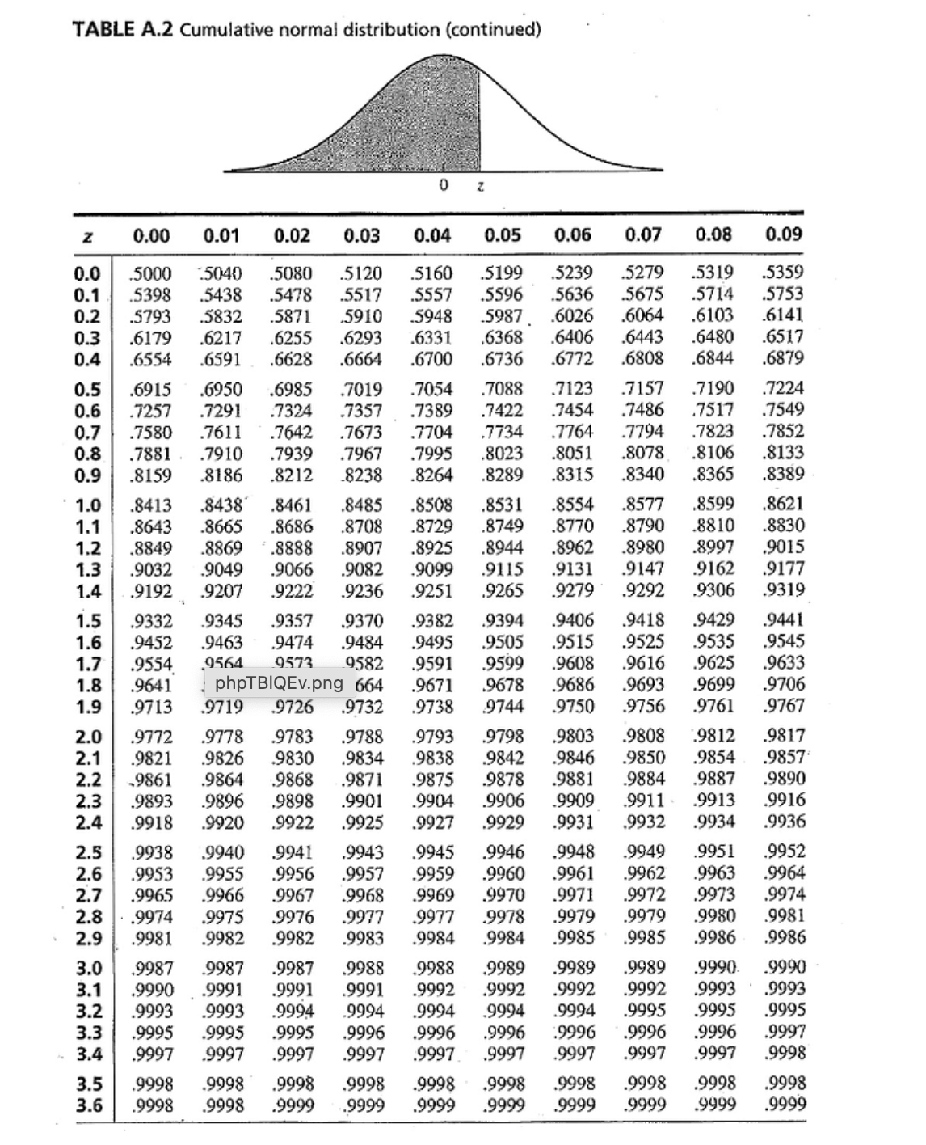
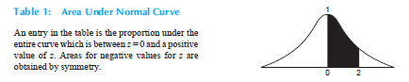
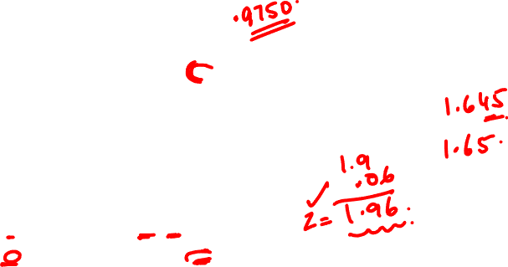
10/11/22
34

Slide 35
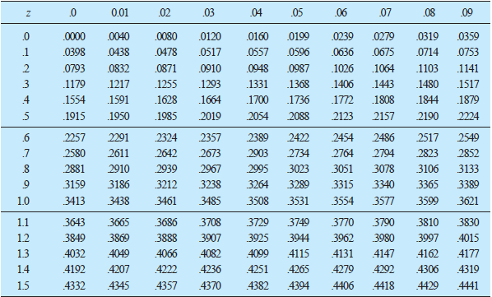
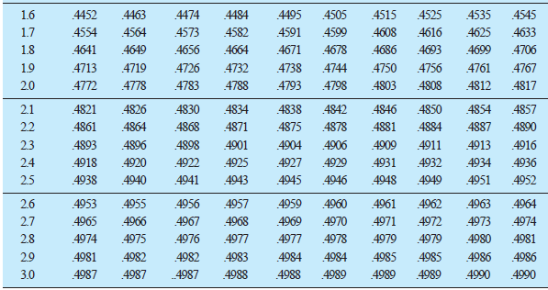
35

Slide 36
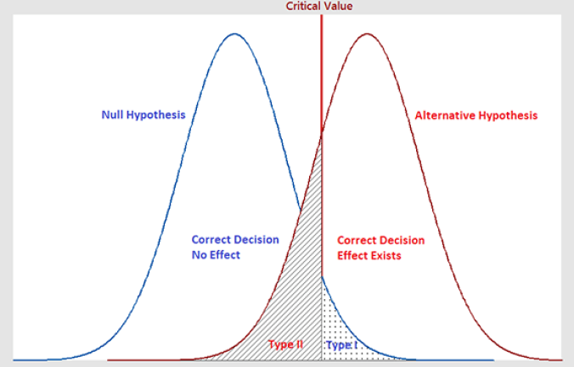

Statistical Power of Hypothesis Test
H0 : no effect/no change
Ha : effect/change
Type 1 Error (α) = Prob(Reject H0| H0 is True)
Type 2 Error (β) = P (not Rejecting H0 | H0 is False)
Accepting Null Hypothesis when its should be Rejected.
Failure to choose Ha when Ha is True.
There is "no effect" when in reality there is "effect"
Hypothesis Test is not able to "detect a change", where as in reality there is a "change"
False Negative: Test result says "No evidence to reject H0" (Accept H0)
Eg: Hypothesis test says: Medicine is "not effective" when its actually effective.
36

Slide 37
Statistical Power of Hypothesis Test
H0 : no effect/no change
Ha : effect/change
β = Failure to choose Ha when Ha is True. (desirable to be a low value)
Power of Hypothesis Test (1- β) : The power of a test is the probability of making the correct decision when the alternative hypothesis is true.
Power is the ability(likelihood) of the test to detect an effect that exists in the population.
High Power is desirable (>= 80%)
Procedure:
Do Hypothesis test at a significance level (α) ( eg. =5%, 1%)
Calculate the Power (1- β) of the test.
if its acceptable (>= 80%), then sample size is ok.
Otherwise increase sample size
37

Slide 38
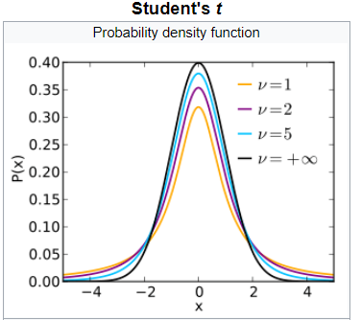
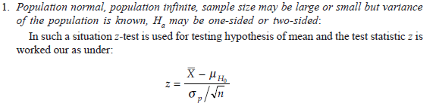
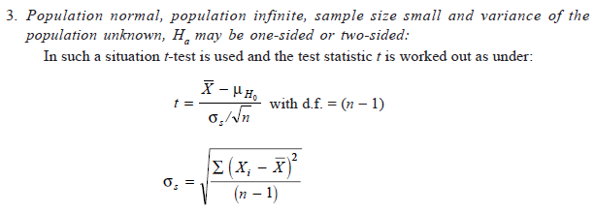
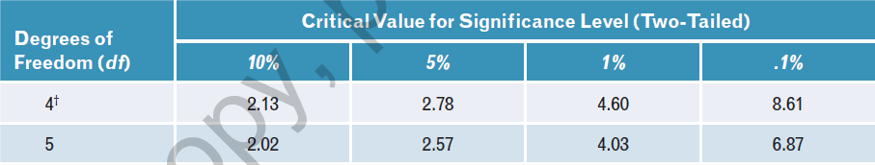
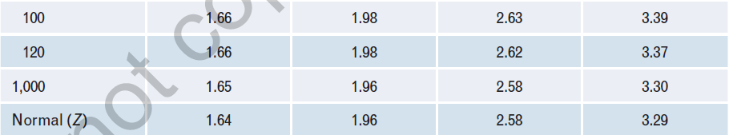
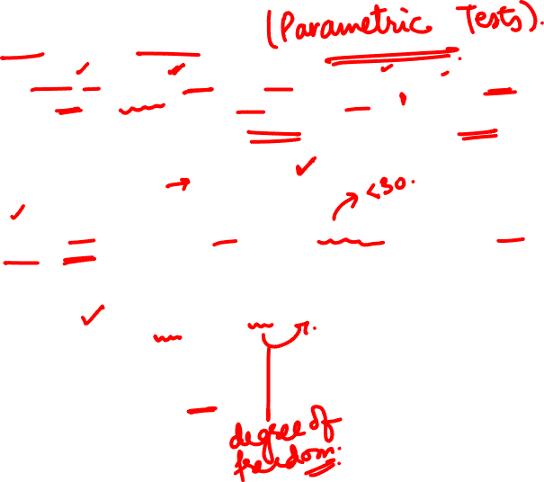

z-test vs t-test
38

Slide 39

z-test vs t-test
39

Slide 40

A Quick Review

Slide 41
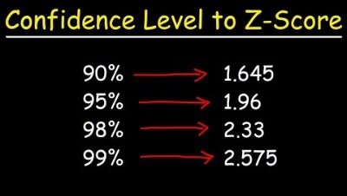
Example of a z-test

Slide 42
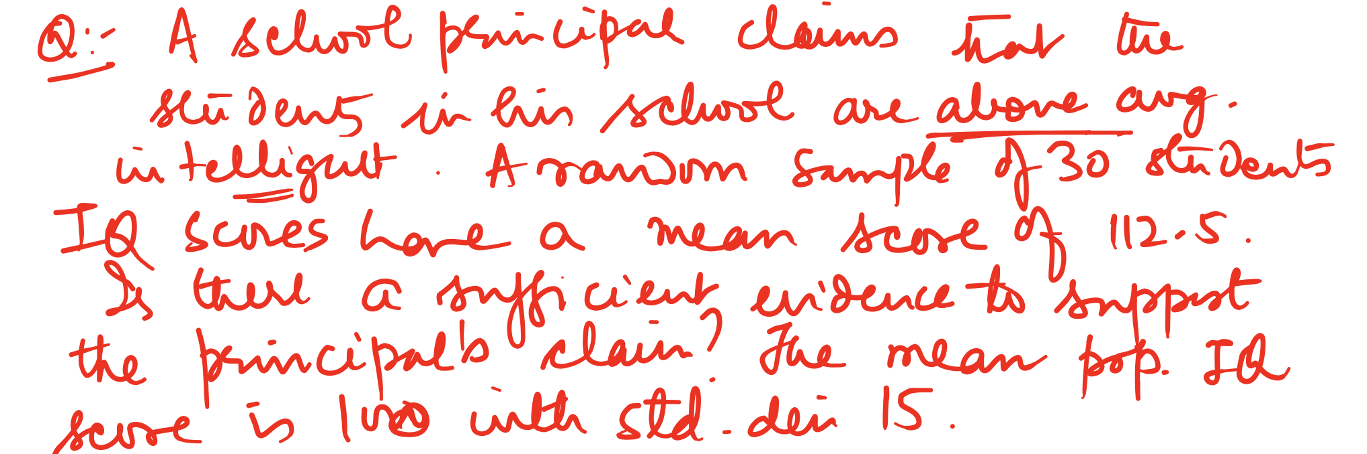
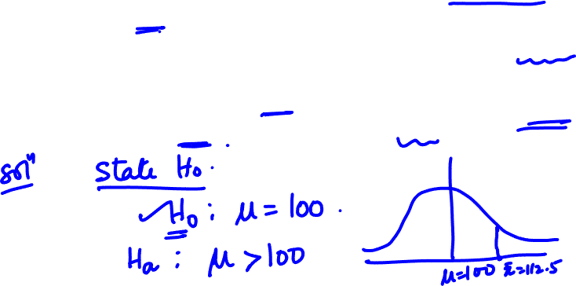

Slide 43
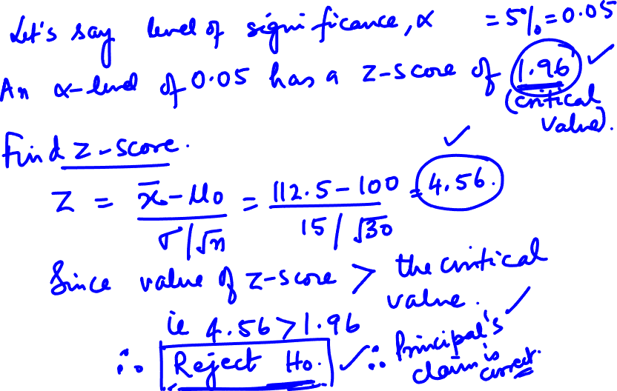

Slide 44
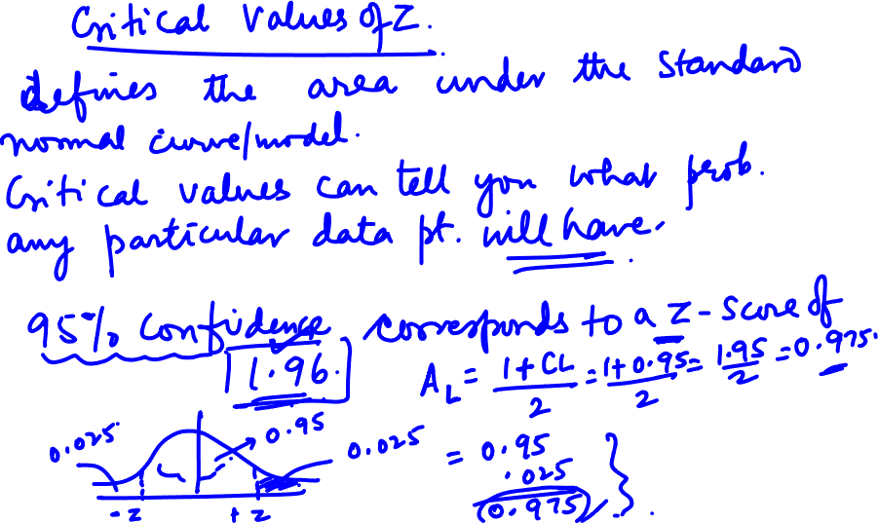

Slide 45
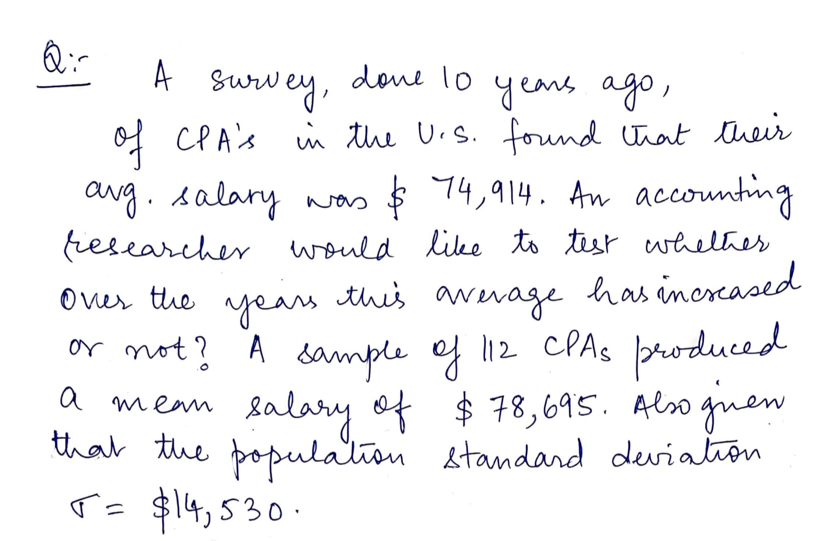
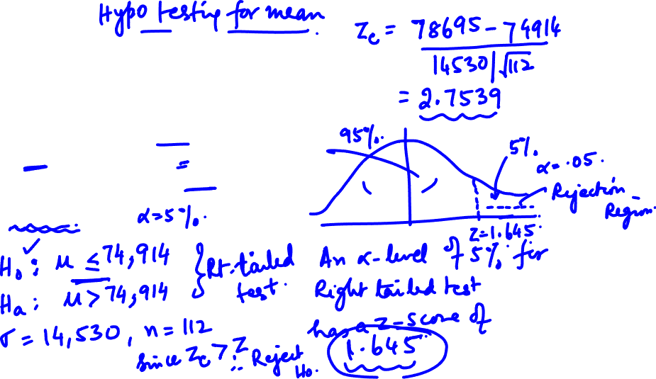

Slide 46
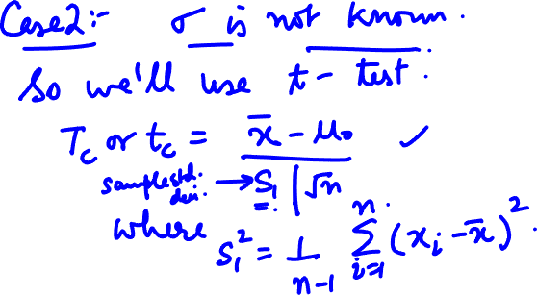

Slide 47



Slide 48


Slide 49




Slide 50


Slide 51


Slide 52


Slide 53



Slide 54


Slide 55



Slide 56


Slide 57


Slide 58



Slide 59


Slide 60



Slide 61



Slide 62


Slide 63
Eg. Hypothesis Testing
The average IQ for the adult population is 100 with a standard deviation of 15. A researcher believes that
this value has changed. So a IQ test is conducted on 75 random adults, resulting in avg IQ of 105.
Is there enough evidence to suggest that the avg IQ has changed. (Assume α = 5%)
What is the power of the test for μ = 105.
1. State H0 and HA
2. Specify α
3. Choose sampling distribution
4. Calculate test statistic (Z_{c})
5. Calculate Probability (P)
6. P < α (one tailed)
P < α/2 (two tailed)
Yes => Reject H₀
(Statistically Significant)
No => Accept H_{a}
63

Slide 64
Eg. Hypothesis Testing
The average IQ for the adult population is 100 with a standard deviation of 15. A researcher believes that
this value has changed. So a IQ test is conducted on 75 random adults, resulting in avg IQ of 105.
Is there enough evidence to suggest that the avg IQ has changed. (Assume α = 5%)
What is the power of the test for μ = 105.
H0 = μ = μH0 = 100
Ha = μ ≠ 100
1. State H0 and HA
2. Specify α
3. Choose sampling distribution & critical value (based on α )
4. Calculate test statistic (Z)
5. Calculate Probability (P)
6. P < α (one tailed)
P < α/2 (two tailed)
Yes => Reject H₀
(Statistically Significant)
No => Accept H_{a}
α = 5%
Z distribution : 2-tailed:
$$Z=\frac{\overline{x}−μ}{\frac{σ}{\sqrt{n}}}=\frac{105−100}{\frac{15}{\sqrt{75}}}=2.89$$
Since 2.89 > 1.96
There is evidence to reject H0.
There is evidence that IQ has changed.
= 1 - 0= 1-[0.5+ = 0.4981 = 0.0091 < 0.025
Since
There is evidence to reject H0.
There is evidence that IQ has changed.
64

Slide 65
Eg. Hypothesis Testing
A chemical process produces 15 lbs or less of waste for every 60lb batch, with a SD of 5 lbs. A random sample of 100 batch gave an average waste of 16 lbs per batch.
Has the wastage increased at a significance level of 10%.
Compute the power of the test for μ = 16.
If the significance level is increased to 20%, what is the new power of the test for μ = 16.?
1. State H0 and HA
2. Specify α
3. Choose sampling distribution
4. Calculate test statistic (Z_{c})
5. Calculate Probability (P)
6. P < α (one tailed)
P < α/2 (two tailed)
Yes => Reject H₀
(Statistically Significant)
No => Accept H_{a}
65

Slide 66

Eg: t-test
The specimen of copper wires drawn form a large lot have the following breaking strength (in kg.
weight):
578, 572, 570, 568, 572, 578, 570, 572, 596, 544
Test (using Student’s t-statistic)whether the mean breaking strength of the lot may be taken to be
578 kg. weight (Test at 5 per cent level of significance).
66

Slide 67


Chi-Square tests
A chi-square (goodness of fit )test determines if a sample data matches a population.
Used to obtain confidence interval estimate of unknown population variance.
Non-parametric test and as such no rigid assumptions are necessary in respect of type of population.
chi-square can be used
(i) as a test of goodness of fit and
(ii) as a test of independence.
As a test of goodness of fit, test enables us to see how well does the assumed theoretical distribution (such as Binomial distribution, Poisson distribution or Normal distribution) fit to the observed data.
As a test of independence, test enables us to explain
whether or not two attributes are associated (Independent Variable/Dependent Variable)
λ
λ
λ
λ
λ
67

Slide 68

Conditions for chi-square test.
Observations must be random and independent
No group should have freq < 10. When freq are less than 10, group the adjoining groups
Overall no must be large ( > 50)
Constraints must be linear
68

Slide 69

Degree of Freedom
Number of Independent value which are assigned to statistical distribution
( n-1) . Eg: Tossing of a die 132 times
λ
Num on Top | 1 | 2 | 3 | 4 | 5 | 6 | Total
Observed Frequency | 16 | 20 | 25 | 14 | 29 | 28 | 132
Number of Independent value which are assigned to statistical distribution
( (r-1)(c-1)
Observed Frequency | Party A | Party B | Row Total
Male | 55 | 65 | 120 (M)
Female | 50 | 30 | 80
Col Total | 105 (A) | 95 | 200 (N)
λ
69

Slide 70

EXAMPLE
Q: Suppose assembly elections are announced in 3 major states. A major political party wants to test if the proportions of its supporters in the 3 states are the same or not.
The party conducts a sample survey of 1000 people in each state and finds that there are 300, 350 and 425 supporters in the sample in the surveyed states. Using these data, test if the 3 proportions are the same or not?

Slide 71


Slide 72


Test of independence of attributes

Slide 73


Slide 74


Chi square distribution is a continuous distribution. It loses its validity if any expected frequency is less than 5 or sometimes less than 10. In. such cases, the expected frequency is pooled with the preceding or succeeding frequency.

Slide 75


Slide 76


Test of Goodness of fit

Slide 78
Observed Frequency vs Expected Frequency
=Observed frequency in i^{th} row and j^{th} column
=Expected frequency in i^{th} row and j^{th} column.
=
Observed Frequency | Party A | Party B | Row Total
Male | 55 | 65 | 120 (M)
Female | 50 | 30 | 80
Col Total | 105 (A) | 95 | 200 (N)
λ
$$P\left(M\right)=$$
 | Party A | Party B | Row Total
Male |  |  | 120
Female |  |  | 80
Col Total | 105 | 95 | 200
$$P\left(A\right)=$$
$$P\left(A∩B\right)=$$
$$P\left(M∩A\right)=$$
$$E_{AB}=$$
$$E_{11}=$$
$$E_{11}=$$
λ
10/11/22
UE20CS506A
78

Slide 79
Observed Frequency vs Expected Frequency
=Observed frequency in i^{th} row and j^{th} column
=Expected frequency in i^{th} row and j^{th} column.
=
Observed Frequency | Party A | Party B | Row Total
Male | 55 | 65 | 120 (M)
Female | 50 | 30 | 80
Col Total | 105 (A) | 95 | 200 (N)
λ
$$P\left(M\right)={M/N=120}/{200=0.6,P\left(F\right)}=0.4$$
 | Party A | Party B | Row Total
Male |  |  | 120
Female |  |  | 80
Col Total | 105 | 95 | 200
$$P\left(A\right)={A/N=105}/{200=0.525,P\left(B\right)}=0.475$$
$$P\left(A∩B\right)=P\left(A\right)×P\left(B\right)$$
$$P\left(M∩A\right)=P\left(M\right)×P\left(A\right)=0.6×0.525=0.315$$
λ
$$E_{AB}=P\left(A∩B\right)×N$$
$$E_{11}=P\left(M∩A\right)×N=0.315×200=63$$
$$E_{11}=P\left(M∩A\right)×N=P\left(M\right)×P\left(A\right)×N=\frac{M}{N}×\frac{A}{N}×N=\frac{M×A}{N}=\frac{120×105}{200}=63$$
10/11/22
UE20CS506A
79

Slide 80


Calculation of
Number of Independent value which are assigned to statistical distribution
( n-1) or (r-1)(c-1)
λ
Observed Frequency | Party A | Party B | Row Total
Male | 55 | 65 | 120
Female | 50 | 30 | 80
Col Total | 105 | 95 | 200
 | Party A | Party B | Row Total
Male |  |  | 120
Female |  |  | 80
Col Total | 105 | 95 | 200
10/11/22
UE20CS506A
80

Slide 81



$$χ^{2}Table$$
10/11/22
UE20CS506A
81

Slide 82

Q: A die is thrown 132 times with following results: Is the die biased?
λ
λ
λ

Slide 83


Answer
10/11/22
UE20CS506A
83

Slide 84

2. Find the value of X² for the following information
Class | Obs Freq | Exp Freq | Oi – Ei | (Oi – Ei)^2/Ei
A&B
C
D&E

Slide 85

Answer:
10/11/22
UE20CS506A
85

Slide 86
Genetic theory states that children having one parent of blood type A and the other of blood type B will always be of one of three types, A, AB, B and that the proportion of three types will on an average be as 1 : 2 : 1. A report states that out of 300 children having one A parent and B parent,30 per cent were found to be types A, 45 per cent per cent type AB and remainder type B. Test the hypothesis by chi-square test
Class | Obs Freq | Exp Freq | Oi – Ei | (Oi – Ei)^2/Ei
A
AB
B

Slide 87


Answer:

Slide 88


Slide 89


Answer

Slide 90


Answer:

Slide 91
Problem
The table shows the data obtained during outbreak of smallpox.Test the effectiveness of the vaccine at 5% significance level.
H0: The vaccine has no effect; Ha: Vaccine is effective.
Exp Freq | Attacked | Not Attacked | Row Tol
Vaccinated | 500*216/2000=54 | 446 | 500
Not Vaccinated | 162 | 1500*1784/2000= 1338 | 1500
Col Total | 216 | 1784 | 2000
Ob Freq | Attacked(A) | Not Attacked(NA) | Row Tol
Vaccinated(V) | 31 | 469 | 500
Not Vaccinated (NV) | 185 | 1315 | 1500
Col Total | 216 | 1784 | 2000
$$χ^{2}=\sum{\frac{{\left(O_{ij}−E_{ij}\right)}^{2}}{E_{ij}}}=14.66$$
Class | Obs Freq | Exp Freq | Oi – Ei | (Oi – Ei)^2/Ei
V-A | 31 | 54 | -23 | -23^2/54=9.80
V-NA | 469 | 446 | 23 | 23^2/446=1.19
NV-A | 185 | 162 | 23 | 23^2/162=3.27
NV-NA | 1315 | 1338 | -23 | 23^2/1338=0.40
$$df=\left(r−1\right)\left(c−1\right)=\left(2−1\right)\left(2−1\right)=1$$
Critcal value of for df=1,
at 5% level of significance is 3.841
Computed (=14.66) > 3.841.
So reject H0 and conclude that Vaccine is effective.
10/11/22
UE20CS506A
91

Slide 92


Problem
Exp Freq | Blue(B) | Gold(G) | Red® | Row Tol
Dead(D) |  |  | 22.23 | 40
Alive(A) | 123.35 | 49.88 | 216.77 | 390
Col Total | 136 | 55 | 239 | 430
H0 : fatality and shirt color are related
Ha : fatality is not related to shirt color.
@ 5% significance level
Since = 6.17 > 5.991
Evidence to Reject H0 and Accept Ha
10/11/22
UE20CS506A
92

Slide 93

Home work -1

Slide 94

Home work 2

Slide 95
Refer text book and solve worked example problems :- 11.2 , 11.3,11.7 to 11.14. Also solve exercise problems :- 3, 4, 5, 6, 7.
λ
λ

Slide 96

Caution while using Chi square test
1. Should be applied only when the individual observations of the sample are independent.
2. Computation of correct degrees of freedom.
3. Should not neglect the frequencies of non-occurrence.
4. Must make sure that the sum of observed and expected frequencies are same.

Slide 97
THANK YOU
Dr. Arti Arya
artiarya@pes.edu

